Slide 1
Mindful Self-Compassion
Developed by Nancy C. Osborn, PhD & Shelby Nace, LMSW
KC Healthy Kids

Slide 2
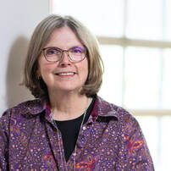
About Us: Dr. Nancy C. Osborn, PhD
Originally from Buckner, MO
Bachelor's in Education, Master's in Counselor Education and Ph.D. in Counseling Psychology
Over 30 years working in community mental health centers in North Dakota and Missouri
Trainer for many years, primarily focused on youth mental health, mindfulness and trauma informed care.
Passionate about health advocacy.
My mission is to provide trauma informed care training to all ages.
Gratefully, I give and get support from my spouse, my 22 year old adopted son and my dogs

Slide 3
About Us: Shelby Mocherman, LMSW
Originally from KCMO
Bachelor’s & Master’s in Social Work
5 Years working in a Child Advocacy Center w/ victims of abuse
3 Years working for the school system in Nashville
3 Years as a yoga/group fitness instructor
Passionate about exercise, educating others in Trauma-Informed Care, and mindfulness,
Outside of work I enjoy cooking, roller derby and spending time with loved ones, including my dog.
Big feelings person!

Slide 4
Objectives
Participants will be able to describe why self-compassion is important for everyone.
Participants will be able to define tender and fierce self-compassion.
Participants will be able to list the self-compassion myths or what it is not.
Participants will be able to list and describe the 3 elements of self-compassion according to Kristen Neff, Ph.D.
Participants will be able to list at least 2 ways people can be compassionate toward themselves.

Slide 5
Trauma-Informed Perspective
People’s behavior is the result of what has happened to them.
The reason people behave the way they do is the result of them getting their needs met.
People’s behavior is the result of their past experiences.
People are doing the best they can.

Slide 6
People includes you and me.

Slide 7
Self Compassion Exercise
Please write down answers to the following questions:
Think about various times when you’ve had a close friend who was struggling in some way- had a misfortune, failed or felt inadequate. How would you typically respond to your friends in such situations? What would you say? How is your posture? What are your non-verbal gestures?

Slide 8
Self Compassion Exercise
Please write down answers to the following questions:
Think about various times when you were struggling in some way- had a misfortune, failed or felt inadequate. How would you typically respond to yourself in such situations? What would you say? How is your posture? What are your non-verbal gestures?

Slide 9
Self Compassion Exercise
Consider the differences between how you treat your close friends when they are struggling and how you treat yourself. Do you notice any patterns?

Slide 11
What Self-Compassion is Not: Common Misconceptions
“Self-compassion is just a pity-party for me”
“I have to be tough and strong to get through life”
“I need to think more about other people than I do about myself”
“Self-compassion will make me lazy, or let me get away with anything!”
‘I’ll never succeed to the level that I want without harsh self-criticism”

Slide 12
Self-compassion myths
Kristen Neff, Ph.D. (2015)
Self compassion is a form of self-pity
Self-compassion means weakness
Self-compassion will make me complacent
Self-compassion is narcissistic
Self compassion is selfish

Slide 13
Neuroscience
Dr. Rick Hanson
Our brains are hardwired to have a negativity bias which kept us safe millions of years ago but not so much now.
Positive interactions/experiences are like teflon or a nonstick pan–they just slide off and we don’t remember them or take them in.
Negative interactions/experiences are like velcro–they get stuck in our brains.

Slide 14
Dr. Kristen Neff
“Instead of mercilessly judging and criticizing yourself for various inadequacies or shortcomings, self-compassion means you are kind and understanding when confronted with personal failings – after all, who ever said you were supposed to be perfect?”

Slide 15
Self-Compassion Test, Dr. Kristen Neff
https://self-compassion.org/self-compassion-test/

Slide 16
The Three Elements of Self-Compassion
Common Humanity
Mindfulness
Self-Kindness

Slide 17
Self-Kindness
Self kindness counteracts our tendency to tear ourselves down.
Rather than being critical, self-kindness allows us to be supportive and encouraging.
Rather than attacking or berating ourselves, we offer ourselves warmth and unconditional acceptance.
When life circumstances are too difficult to bear, we soothe and comfort ourselves.

Slide 18
Common Humanity
In order to practice self-compassion, we acknowledge and know that we are interconnected to others.
We recognize that all humans are flawed and works-in progress.
Self-compassion honors the unavoidable fact that life entails suffering.
We will all make mistakes and endure hardships in life.
The pain we feel in difficult times is the same pain others may experience in difficult times.

Slide 19
Mindfulness
MIndfulness involves being aware of our moment to moment experience in a clear and balanced manner.
When we are mindful, we are open to the reality of the present moment.
We allow all thoughts, emotions and sensations to enter our awareness without resistance.
When we are mindful, we can observe our own pain without exaggerating it, allowing us to take a wiser and more objectives perspective to ourselves and our lives.

Slide 20
Fierce self-compassion
Has the same components listed above but the process is different
It is still about alleviating suffering but fierce self-compassion requires taking action
May require motivating ourselves or others, taking brave action providing for ourselves or others and/or protecting ourselves or others
It is still coming from a “place of love and support.” (S. Kiesling, 2021)
Mama Bear examples

Slide 21
Self-Compassion and Suffering
“Without suffering, you have no ways in order to learn how to be understanding and compassionate.” - Thich Nhat Hanh
It is important to acknowledge that suffering is a part of life which is inevitable. Mindfulness teaches us to fully acknowledge our own happiness and suffering, in order to notice the happiness and suffering of others.
Most of us try to resist what we find unpleasant, but we find that what we resist persists.
When we are not trying to run away from suffering anymore, we can make use of it in order to build peace and happiness in ourselves and others.
What we can feel, we can heal.

Slide 22
Letting Go of Resistance Exercise

Slide 23
How Do I Cause Myself Unnecessary Suffering?
Think of a current situation in your life where you feel that resisting the reality of a situation is creating unnecessary suffering for you (harboring anger against someone, procrastinating a big project, etc.)
How do you know you’re resisting? Is there discomfort in the body or mind?
What are the consequences of resisting?
Can you see that resistance might be serving you in some way?
Consider how mindfulness or self-compassion may help to lessen your resistance. Can you validate your own pain?

Slide 24
Fierce Self-Compassion vs. Tender Self-Compassion
How do you see the difference between fierce and tender self-compassion?
How do you see the differences in your own life?

Slide 25
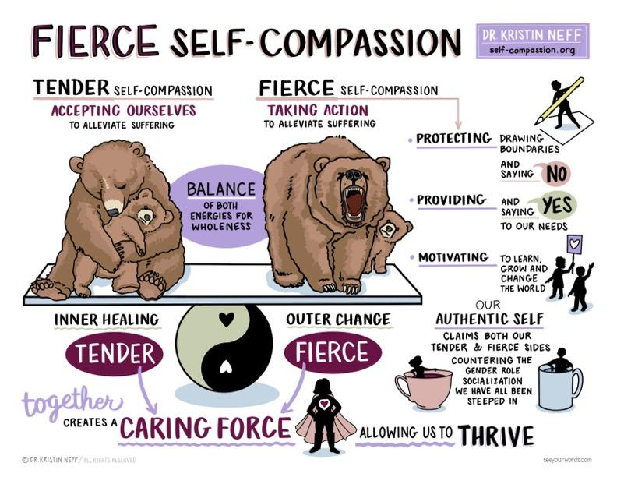

Slide 27
Dr. Neff:
Give yourself permission to treat yourself with kindness
Treat yourself as you would a friend (write a letter…)
Physical touch (hands over heart, hug…)

Slide 28
How neural connections work?

Slide 29
Meditation on Fierce Self-Compassion
Fierce self compassion break

Slide 30
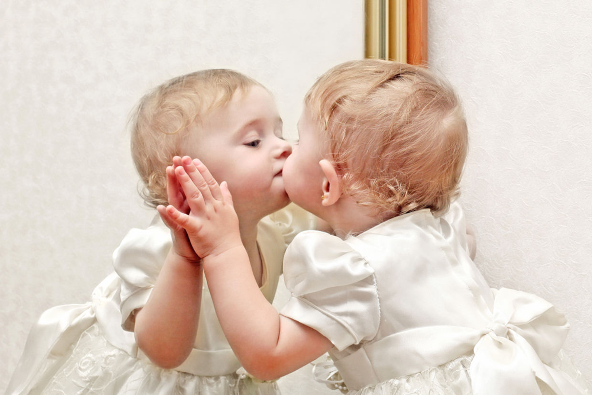
Take it easy on yourself

Slide 31
References
Fierce Self-Compassion break (Greater Good in action). (2023, March 20). https://ggia.berkeley.edu/practice/fierce_self_compassion_break
Mike Rother. (2014, June 12). How We Learn - Synapses and Neural Pathways [Video]. YouTube. https://www.youtube.com/watch?v=r1sDjWfDa4w
Neff, K., & Germer, C. K. (2018). The mindful self-compassion workbook: A proven way to accept yourself, build inner strength, and thrive. Guilford Press.
Neff, K. (2021). Self-compassion: The proven power of being kind to yourself. Yellow Kite, an imprint of Hodder & Stoughton.
Mike Rother. (2014, June 12). How we learn - synapses and neural pathways [Video]. YouTube. https://www.youtube.com/watch?v=r1sDjWfDa4w

Slide 32
References Continued
Mindfulness, Suffering, and Engaged Buddhism | Plum Village. (2019, October 11). Plum Village. https://plumvillage.org/about/thich-nhat-hanh/interviews-with-thich-nhat-hanh/thich-nhat-hanh-on-mindfulness-suffering-and-engaged-buddhism
Self-Compassion. (2021, October 27). Test how self-compassionate you are - Self-Compassion. Self-Compassion - Dr. Kristin Neff. https://self-compassion.org/self-compassion-test/
Sounds True. (2017, October 4). The Power of Self-Compassion | Kristen Neff and Chris Germer [Video]. YouTube. https://www.youtube.com/watch?v=BTQP7XzDxjI
The Five Myths of Self-Compassion. (n.d.). Greater Good. https://greatergood.berkeley.edu/article/item/the_five_myths_of_self_compassion
UMNCSH. (2013, October 1). 2-Minute Tips: How to practice Self-Compassion [Video]. YouTube. https://www.youtube.com/watch?v=Qes9HoxfkE0

